Slide 1

Security & Analysis In Software-Defined Networks
Master’s Degree
Development & Security
of Informational Systems
Postgraduate Student: Konstantinos Karachalis, f3312307
Supervising Professor: George Xylomenos
Assistant Professors: Nicholas Fotiou, Anna Kefala

Slide 2
Contents – Section Table
01 - What is Software-Defined Network? – pp. 3-5 | Definition of the network concept, known as Software-Defined Network
02 - Software-Defined Network – Benefits & Obstacles – pp. 6-8 | SDN network concept bears the responsibility of overcoming challenges left by its predecessor as well as represents a technology of many possibilities | Pros/Cons Explanation
03 - Software-Defined Network - Architecture Model & Layers – pp. 9-16 | Deepful insight of the inner workings and structure of the Software-Defined Networks | Relationships & Tasks – Vital Components of each layer that SDN entails
04 - SDN – Network Security – Vulnerabilities – pp. 17-22 | Primal Attack Points – Susceptibilities In the SDN structure
05 - SDN – Network Security – Threats & Countermeasures – pp. 23-27 | Prevention & Mitigation Methods, Technologies – Implemented in SDN
06 - SDN – Network Security – Use-Case – pp. 28-37 | Distributed Denial-of-Service Attack Representation – SDN Controller, Switching Device, Hosting Device – Mininet SDN Platform
For more info (Master’s Thesis): Security & Analysis of Software-Defined Networks
You can visit more projects on the related field: https://github.com/Kkostakis

Slide 3
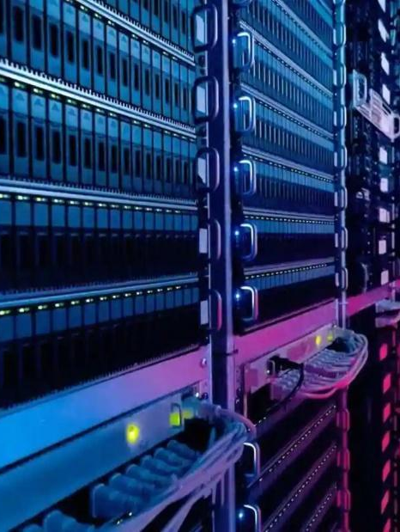
01
What is Software-Defined Network?

Slide 4
Software-Defined Networks - Interpretation
SDN – Defined – GFG
Software-defined networking (SDN) is an approach to network management that enables dynamic, programmatically efficient network configuration to improve network performance and monitoring. This is done by separating the control plane (which decides where traffic is sent) from the data plane (which actually moves packets to the selected destination).
Distinctive Characteristics of SDN
Abstraction of Control from Data plane
Programmability of Control Plane
Programmable Interfaces (APIs) handling communication amidst its layers

Slide 5
SDN – Control Plane
The control plane is mainly tasked with performing the decision-making processes regarding the way the data packets circulating around the network are going to be forwarded (rules, policies). For instance, the construction of the routing devices and related tables represent a part of the control plane, which is why the forwarding rules and the optimal paths that the data packets are supposed to follow are provided by the control plane.
SDN – Data Plane
The main task of the data plane in is the forwarding of data packets. When a packet is received, the device is capable of identifying the matching forwarding rule and sends the packet to the next destination. Unlike traditional networks, where forwarding is based on IP or MAC addresses, SDN allows packet forwarding to be determined by various parameters, for instance TCP or UDP ports, VLAN tags, and the switch port where the packet entered.

Slide 6
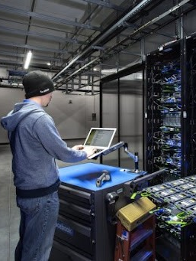
02
Software-Defined Network Benefits & Obstacles

Slide 7
Software-Defined Networks - Benefits
Enhanced Scalability
Improved Performance
Scaling does not require extra physical hardware, RAM, or processing power upgrades.
Virtual functions hosted on cloud servers eliminate the need for on-site equipment upgrades.
Expanding organizations can easily deploy security tools as infrastructure grows, supporting operational scalability.
Centralization of decision-making process ➔ Leads to better role tasking & coordination
Control of the overall network & constant feedback from swiching devices & controller
Less prone to conflicting issues with rules and existing policies
Facilitated Configuration
Networking Design
Implementation of SDN ➔ Unification of the control plane across various network devices.
This unification enables the configuration of these devices from a single, centralized point, allowing for automated control via software.
Abstraction of control plane from data plane, programmability of control plane
Dynamic Global Control – Cross Layer Information
Centralized control which enables facilitated configuration via automation mechanisms

Slide 8
Software-Defined Networks - Obstacles
Deployment Complexity
SDN Requirement – Implementation into existing legacy networking systems
Compatibility Issues Arise ➔ Leading to expensive hardware upgrades to ensure greater compatibility
Increasing Complexity – SDN Deployment
Interoperability Issue
Adaptation & Maintenance
Newly introduced networks are typically compatible with SDN, making implementation straightforward
Transitioning legacy networks to SDN is more complex due to critical systems supported by existing infrastructure
Implementation of the SDN usually has as requirements consistent testing and phased deployments
Organizations are required to upgrade their network infrastructure & implement robust security mechanisms ➔ Adaptation & Maintenance process becomes more costly

Slide 9

03
Software-Defined Network Architecture Model & Layers

Slide 10

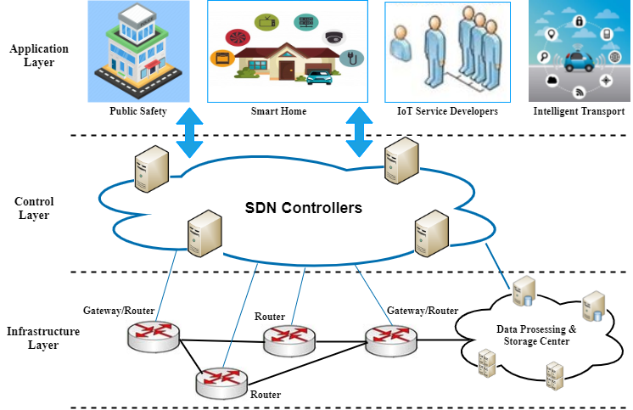
Software-Defined Networks – Architecture Model
Infrastructure Layer:
➔ Entails the underlying network that is consisted of switching devices & routers, which are tasked with forwarding traffic to their respectful destination according to their rules and policies.
➔ Policies & rules (directives) are provided by the SDN controller.
Control Layer:
➔ Acts as a representation of the SDN Controller software from which the admin can take control of the overall network.
➔ The SDN controller is responsible for the decision-making processes regarding the management of rules, policies, the interaction and the stability amidst the layers as well as for overseeing the flow of traffic.
Application Layer:
➔ Comprised of the network programs and software applications that communicate with the underlying second layer of the SDN architecture, sending across their desired network behavior pattern & conditions.

Slide 11
Software-Defined Networks – 1st Layer
Switching/R. Device: The switching devices in SDN are consisted of the memory and the switching fabric, which are important elements for the two planes: control and data plane. For the data plane, the switch demonstrates forwarding of data packets via the processor unit, based on the forwarding rules indicated by the 2nd layer.
Infrastructure Layer
Control Plane
Switching/R. Device
Data Plane
Trans. Media
Southbound Interface
Control Plane & Data Plane: Decision-Making Process – Data Packet circulation, Rule & Policy Forwarding.
Data Packet Forwarding – Receival of Data Packets – Identification of the matching forwarding rule & sending the packet to the next destination.
East/W.
API
Control Layer
SDN Controller
Policies/Rules T.
Performance - Measurement
Media of Transmission: Transmission media, such as optical, wired, and wireless, should be integrated into the Software-Defined Network (SDN) environment to ensure comprehensive coverage. ➔ Diversity in transmission media introduces unique configurations and specific management technologies. ➔ Their incorporation in SDN wireless and optical networking environments, including Software-Defined Radios, which promote cost-effective advancements in radio devices.
Northbound Interface
Application Layer
Cloud Computing
Application Security
N . Application Management

Slide 12
Software-Defined Networks – 1st Interface
Infrastructure Layer
Southbound Programmable Interface: Primarily tasked with the interaction and communication amidst the Software-Defined Networking Controller and the forwarded in the 1st layer as well as for the communication with SDN Controller and the network systems that are manifested via interfaces.
The connection that is instantiated amidst the network systems follows the TLS protocol, providing security and authentication factors in the connection.
Administration of the virtual and/or physical systems in the SDN by the Controller is only feasible provided that is entails the appropriate drivers.
Control Plane
Switching/R. Device
Data Plane
Trans. Media
Southbound Interface
East/W.
API
Control Layer
SDN Controller
Policies/Rules T.
Performance - Measurement
Northbound Interface
Application Layer
Cloud Computing
Application Security
N . Application Management

Slide 13
Software-Defined Networks – 2nd Layer
SDN Controller: An SDN controller manages flow control to the switching and routing devices, through the southbound interface (below) and the applications and business logic through the northbound interface (above) to deploy intelligent networks. They consolidate and mediate between different controller domains using common application interfaces.
Infrastructure Layer
Control Plane
Switching/R. Device
Data Plane
Trans. Media
Southbound Interface
Policies & Rules Table: Rendering policies and rules as appropriate or dysfunctional is a very important process ➔ Ensures the stability of the decision-making process of the control layer ➔ Stability entails the optimal performance of the SDN controller, management of the configuration (new & existing), avoiding potential conflicts as well as potential compromise events. Example of said tools: FlowChecker.
East/W.
API
Control Layer
SDN Controller
Policies/Rules T.
Performance - Measurement
Measurement of Performance: A key issue for SDN controllers is limited processing power, which can lead to performance bottlenecks. Benchmarking tools like OpenFlow Controller Benchmark, Cbench, Iperf ➔ Address scalability by identifying these bottlenecks and enhancing processing speeds, providing metrics like response time and packet drop rates per switch.
Well-defined divination of the workload and precise role assignments are able to enhance the performance of the control layer ➔ Restructures the way the switches are organized in the SDN.
Northbound Interface
Application Layer
Cloud Computing
Application Security
N . Application Management

Slide 14
Software-Defined Networks – 2nd Interface
Infrastructure Layer
Control Plane
Switching/R. Device
Data Plane
Trans. Media
Northbound Programmable Interface: Mainly responsible for the connection amidst the 2nd and 3rd layers.
Capable of implementing the programmability factor of the SDN controllers into the controllers that are utilized by applications for the 3rd layer through the exposure of the circulating data and the operations that exist inside the utilized SDN controllers.
Southbound Interface
East/W.
API
Control Layer
SDN Controller
Policies/Rules T.
Performance - Measurement
Northbound Interface
Application Layer
Cloud Computing
Application Security
N . Application Management

Slide 15
Software-Defined Networks – 3rd Layer
Cloud Computing: The rapid advancement of cloud computing has influenced SDN, enabling on-demand services and expanding Infrastructure as a Service (IaaS) capabilities.
➔ SDN supports cloud efficiency by enhancing scalability, dynamic resource provisioning, and network visibility. Tools like Open vSwitch (OVS) and vCRIB address virtualization challenges in cloud environments, managing virtual and physical switch rules and adapting to dynamic traffic.
Infrastructure Layer
Control Plane
Switching/R. Device
Data Plane
Trans. Media
Southbound Interface
Application Security: SDN applications, security is enhanced by centralized management ➔ Allowing comprehensive monitoring and policy enforcement across networks.
➔ SDN’s programmability enables it to detect threats like DDoS and replay attacks, sending real-time alerts and directing traffic to intrusion detection/prevention systems (IDS/IPS).
East/W.
API
Control Layer
SDN Controller
Policies/Rules T.
Performance - Measurement
Northbound Interface
Network Application Management: Network applications often experience failures due to configuration errors, typically caused by human mistakes. Traditional tools like ping and traceroute lack automated maintenance capabilities ➔ SDN provides centralized, automated rule enforcement to prevent such errors and tools like Network Debugger enhance SDN’s capabilities ➔ reducing manual work and supporting automated network maintenance.
Application Layer
Cloud Computing
Application Security
N . Application Management

Slide 16
Software-Defined Networks – East/Westbound Interface
Infrastructure Layer
Control Plane
Switching/R. Device
Data Plane
Trans. Media
East/Westbound Programmable Interface: Its primary role is to provide a specific communication interface which enables the synchronization of the state for allocated Software-Defined Networking Controllers within the Control Layer ➔ Achieving higher availability.
Capable of performing data importation and exportation amidst the SDN Controllers as well as performing state monitoring aiming to ensure whether the SDN Controller is in UP state or send a notification for a takeover for the appropriate set of forwarded components.
Southbound Interface
East/W.
API
Control Layer
SDN Controller
Policies/Rules T.
Performance - Measurement
Northbound Interface
Application Layer
Cloud Computing
Application Security
N . Application Management

Slide 17

04
SDN – Network Security Vulnerabilities

Slide 18

SDN – Susceptibility – Software-Defined Network Controllers
Vulnerabilities | Consequences – Adverse Effects
SDN (Software-Defined Network) controllers manage key network operations | Routing, Packet forwarding rules, Network monitoring, Information gathering, Configuration of the networking environment ➔ Severely are the main target for malicious actors
Centralized control through a single SDN controller creates a limited but vulnerable target for attackers | Easier for attackers to exploit and impact the network due to a single point of control ➔ If the controller is compromised, the entire SDN domain can be negatively affected
A single SDN controller setup poses a risk of becoming a single point of failure (SPOF) | Malicious attacks like UDP flooding or DNS poisoning can quickly overwhelm the controller ➔ Performance drops rapidly, and network functions may cease entirely if the controller is incapacitated
In multi-controller SDN environments, communication between controllers is necessary to maintain network stability | Without security protocols (e.g., TLS/SSL), data packets exchanged among controllers are vulnerable ➔ Interception methods, such as packet sniffing, allow attackers to gather critical information from these communications

Slide 19

SDN – Susceptibility – Open Nature of Application Programmable Interface (API)
SDN (Software-Defined Network) architecture relies on open application programmable interfaces (APIs), making it more vulnerable to cyberattacks
➔ Open APIs often expose vulnerabilities inherent in SDN software and as a result software vulnerabilities arise from Conflicting interactions
➔ Rules among various software applications with differing goals & these conflicts can cause inconsistent, chaotic behavior in switching devices within the SDN
Cloud-based management of SDN applications adds security risks:
➔ SDN applications handled by cloud providers may perform unauthorized actions due to workload and cost-efficiency objectives
➔ Developers lack visibility and control over these third-party-managed applications, limiting their ability to address security issues

Slide 20
SDN – Susceptibility – Open Nature of Application Programmable Interface (API)
Open APIs in SDN create potential entry points for attackers:
➔ Attackers can study exposed elements and plan targeted attacks
➔ Open programmable interfaces may serve as backdoors for embedding malicious software, such as trojan viruses
Security policies and evaluation mechanisms for APIs are essential:
➔ Robust security measures are needed to assess and safeguard the programmable interfaces provided by SDN controllers
Vulnerabilities extend to the application layer within the SDN architecture:
➔ Applications on the SDN controller share the same physical hardware, connecting via the northbound API
➔ If an attacker compromises the controller, embedded malicious scripts could be executed, resulting in harmful activities throughout the SDN

Slide 21
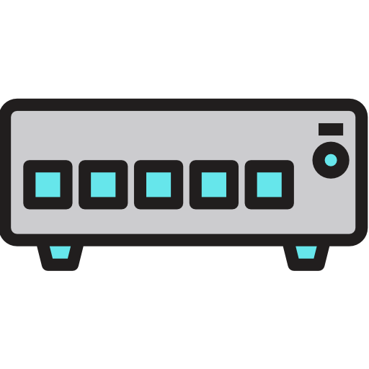
SDN – Susceptibility – Software-Defined Network Switching Devices
SDN architecture includes switching devices, which differ from conventional switches:
➔ Instead of independently matching flows, they communicate with the SDN controller for instructions
➔ Controllers provide directives, such as packet forwarding rules, for the switches to follow
Unsecured communication between controllers and switches is a vulnerability:
➔ Packet eavesdropping by attackers can lead to rule tampering and insertion of malformed packets
➔ Attackers may send fraudulent rules to manipulate switching device behavior within the SDN
Vulnerabilities extend to communication between switches:
➔ Many data packets transmitted among switches are unencrypted and may contain sensitive user information
➔ These unencrypted transmissions are easily intercepted, especially over wireless links
SDN architecture comprises three layers: Infrastructure, Control, and Application:
➔ Each layer resides in a different network location but requires frequent communication to ensure SDN stability and performance

Slide 22
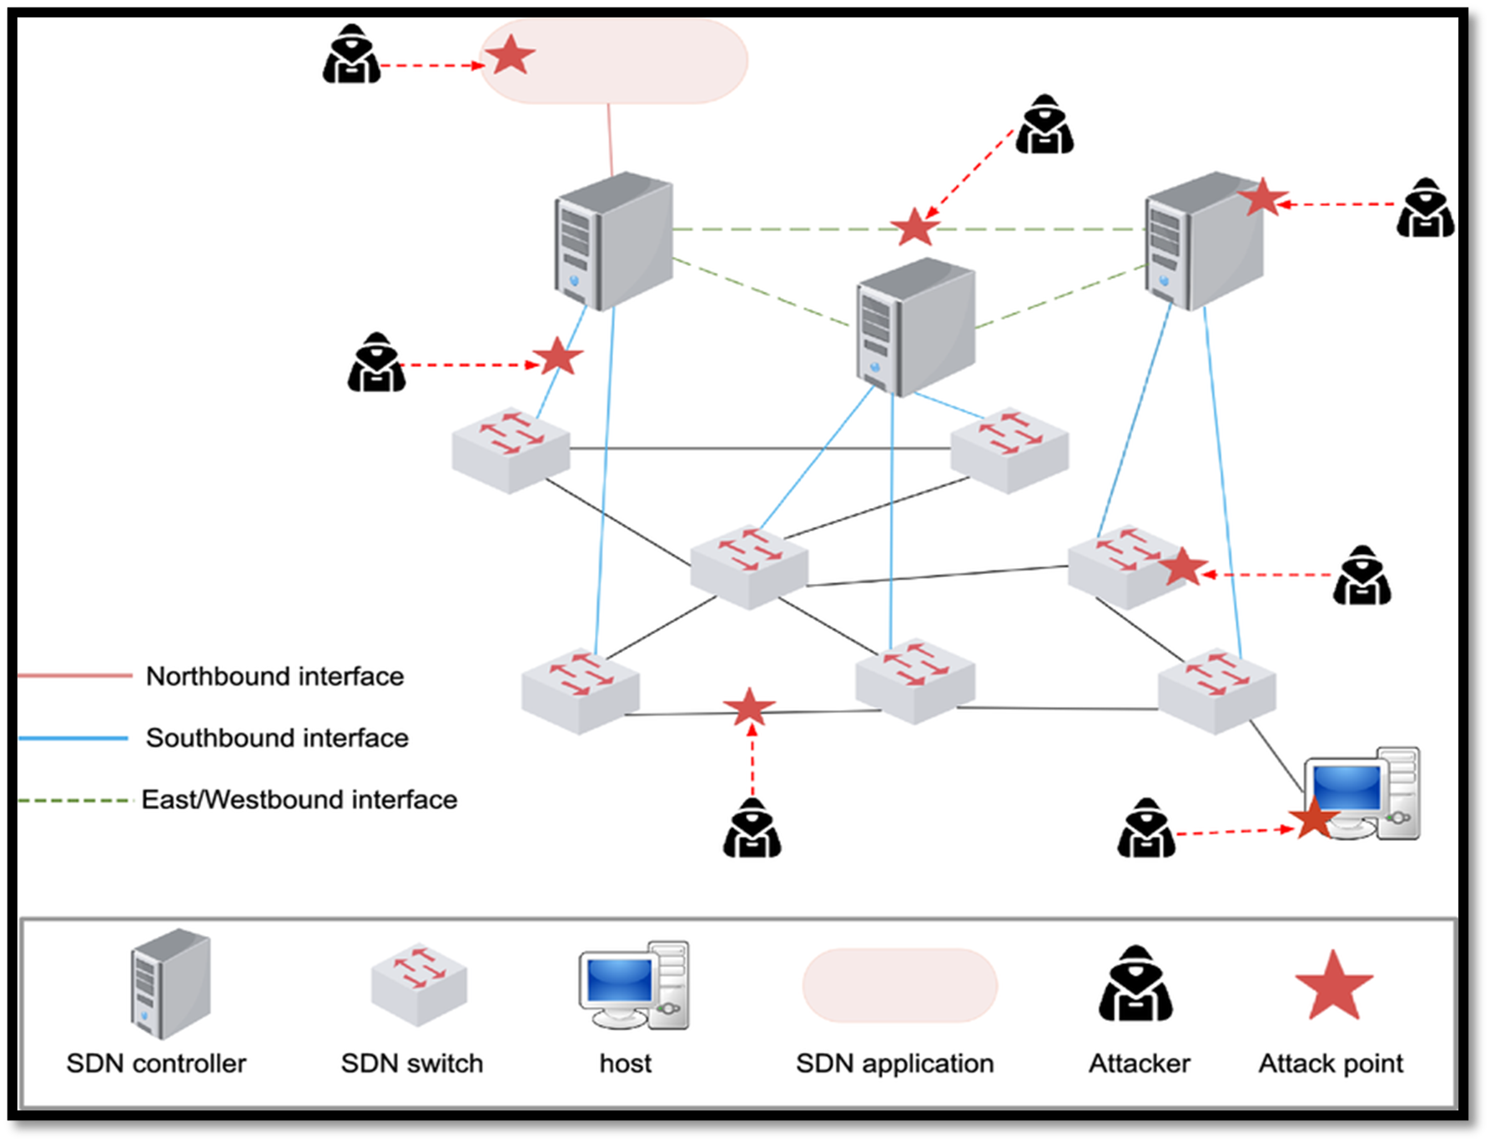
SDN – Susceptibility – Attacking Vulnerable Points

Slide 23

05
SDN – Network Security Threats & Countermeasures

Slide 24
SDN – Infrastructure Layer – Threats & Countermeasure
Threats | Consequences – Adverse Effects | Countermeasures
Denial-of-Service (DoS) Attack – Flow Table & Buffer Saturation | OpenFlow's design flaw ➔ Allowing rule changes for packets without known addresses ➔ attackers can launch DoS or DDoS attacks by flooding the network ➔ quickly exhausting resources and disrupting legitimate data forwarding Attackers can also exploit the limited storage of the buffer flow ➔ Overloading the buffer with TCP packets, attackers force it to delete incoming packets prematurely, further impacting network performance | ➔ Incorporation of Intrusion Detection/Prevention Systems ➔ Virtual Source Address Validation Edge is a platform which entails protection schematics against Denial-of-Service attacks with the architectural design of NOX ➔ Implementation of the framework SFlow-RT
Man-In-The-Middle (MITM) Attack – Controller & Switching Device | A Man-In-The-Middle (MITM) ➔ frequent communication between controllers and switches creates an ideal environment for MITM attacks, where attackers can alter forwarding rules to exploit packet routing and enable ARP poisoning ➔ MITM vulnerabilities affect both physical and virtual SDN connections, as data often traverses multiple switches, increasing susceptibility across controllers and switches in the network | ➔ NOX OpenFlow Controller, performs authentication and source authorization in accordance with a role-based model ➔ VeriFlow, perform instantly validation on the packets sent between two targets on the network. Apart from the support of existing technologies that have been developed for compromise events ➔ FortNox, similar functionality to NOX ➔ Cryptographic Function - Implementation

Slide 25
SDN – Control Layer – Threats & Countermeasures
Threats | Consequences – Adverse Effects | Countermeasures
Distributed Denial-of-Service (DDoS) & Denial-of-Service (DoS) Attack – SDN Controller | Distributed Denial-of-Service (DDoS) attacks target the SDN controller ➔ overloading it to the point of paralysis ➔ rendering its services unavailable to all network users. Attackers flood the network with massive UDP and TCP traffic via compromised devices (bots) ➔ generating malformed packets OpenFlow’s handling limitations ➔ making the controller become overwhelmed with the management of the high-volume traffic, depleting resources, saturating bandwidth ➔ causing a rapid decline in SDN network performance and functionality. | ➔ FloodGuard, a security framework that is SDN-aligned and entails two basic elements Analyzer of Active Flow and Packet Migration ➔ CONA, a node proxy that is situated amidst the client and the server, able to communicate with the SDN controller | Managing all the request messages, data packets that originate from the clients | In case they surpass the intended value, this movement is marked as a potential DDoS event

Slide 26
SDN – Control Layer – Threats & Countermeasures
Model with Various SDN Controllers | Initially designed with a single SDN controller, Software-Defined Networks risked scalability issues and Single-Point-of-Failure (SPOF). Despite multiple controllers, the infrastructure layer still perceives them as a unified entity ➔ Still, rendering it vulnerable as a SPOF ➔ Therefore, necessitating robust security measures for authentication, privacy, and authorization across the network ➔ The dynamic switching between distributed controllers to assume the master role can lead to conflicting configurations, requiring continuous monitoring to prevent potential security threats | ➔ Load balancing, gather information from both the application and the infrastructure layers | Limiting the workload of the controllers and elucidating the configuration process of the applications and the controllers ➔ HyperFlow, distributed event-driven controller framework developed for the OpenFlow protocol ➔ various controllers are running their functional operations at the same time, with every one of the controllers performing decision-making processes at a local level

Slide 27
SDN – Application Layer – Threats & Countermeasures
Threats | Consequences – Adverse Effects | Countermeasures
Conflicting Issues – Rules – Security Policies – Misconfiguration | The application layer in SDN uses security software to access SDN controllers and deliver various network services ➔ The complexity of the apps management ➔ overlapping rules and configuration conflict ➔ difficulty in distinguishing and managing each service's tasks effectively ➔ Due to this management burden, security policies become inadequate, leaving applications connected to controllers more vulnerable to potential attacks | ➔ Flover, tasked with the examination and verification of policies, that are issued for the various flows of traffic circulating in the SDN domain | Offers verification services for the functional operations of the behavior of a OpenFlow network from the aspect of security ➔ Anteater, capable of performing static examination of potential network misconfigurations or conflicts, debugging | Provides validation operations for the infrastructure layer of the SDN
Spoofing – SDN Application | SDN controllers and applications require robust authentication protocols, like TLS (v1.3) and Kerberos ➔ secure communication and prevent information-altering attacks Without these protections, attackers ➔ impersonate legitimate SDN controllers, manipulate traffic statistics, and mislead applications into incorrect decisions, or gain access to sensitive operational data for future attacks | ➔ POX controller into the SDN environment, which is written in the programming language Python and bundled with Mininet SDN network ➔ The application which will be developed on the SDN POX controller will be able to defend against ARP spoofing attacks ➔ Detecting the malformed requests and replies that force the packets to be redirected to malicious domains

Slide 28

06
SDN – Network Security Use-Case

Slide 29
SDN – Distributed Denial-of-Service – Use-Case – Open-Source Tools
Open-Source Tools | Use-Case | Description - Usage
Mininet SDN Framework | It will be the platform that will provide a virtual testing environment for our Software-Defined Network | Use-Case: C.4
SDN Controller FloodLight | Java-Based OpenFlow Controller for SDN which will be utilized as one of the primary tools for Distributed Denial-of-Service Attack in our virtual SDN environment | Use-Case: C.4
Open Virtual Switch (OVS) | This is a multi-layer virtual switch supporting Apache 2.0 and it will be utilized to produce and manage our virtual switching devices | Use-Case: C.4
SFlow-RT | Real-Time analysis open-source tool, utilized for network traffic monitoring and metric, specifically for Software-Defined Network environment and it will be utilized to monitor the state of the controller | Use-Case: C.4

Slide 30

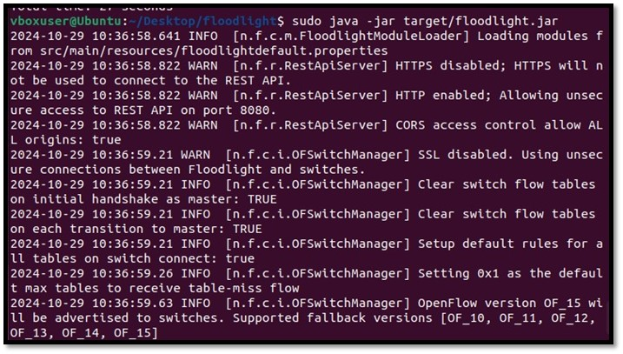
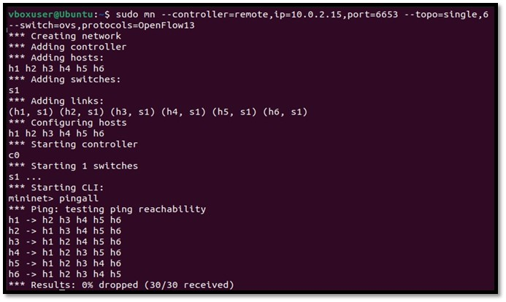
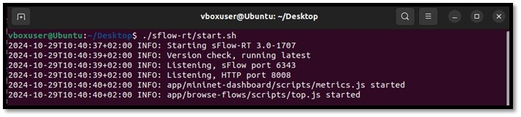
SDN – Distributed Denial-of-Service – Use-Case - Launching

Slide 31
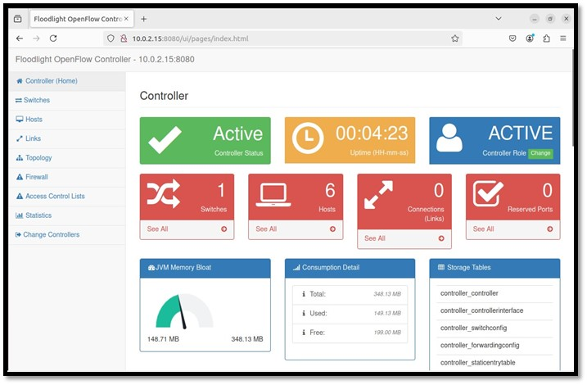
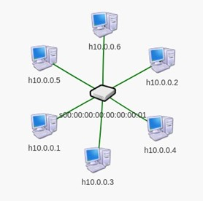
SDN – Distributed Denial-of-Service – Use-Case – FloodLight API & TOPO

Slide 32
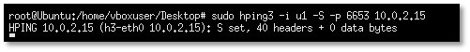
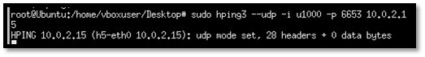
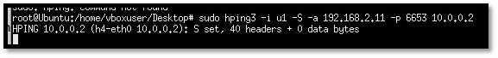
SDN – Distributed Denial-of-Service – Use-Case - Commence
The first command attempts to send multiple (-i u1) TCP SYN packets (-S) towards the port 6653, because this is the default port of the OpenFlow Protocol, on which the FloodLight Controller runs with targeted IP address localhost
While the second command generates thousands (-i u1000) of UDP packets in an attempt to cause UDP flood
The final command creates the IP packets with spoofed IP source address (-a) with destination address the address of the h2 device with port 6653, since it is connected with the controller. Following are details regarding the six hosts of our topology

Slide 33
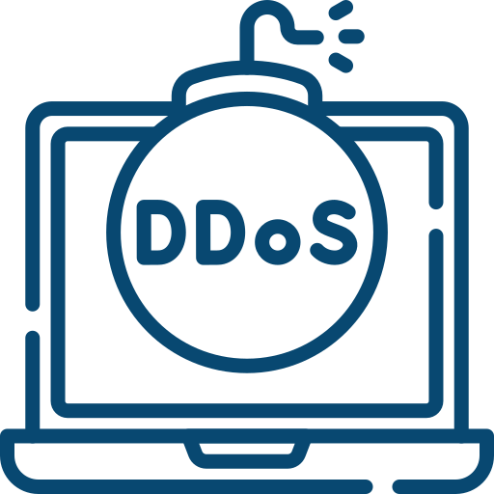
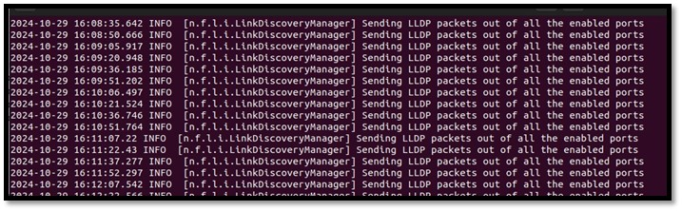
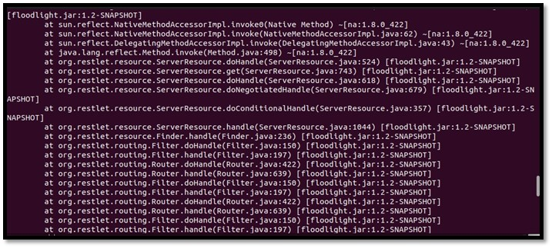
SDN – Distributed Denial-of-Service – Use-Case – FloodLight Overload
The destination port is 6653 is used due to the fact that it is the default service port for the FloodLight SDN Controller. When the attempt was made to refresh the controller, its performance was dropped dramatically with it being slowed down. From the sheer amount of the packets sent, it caused the controller to show timeout error (controller overload)

Slide 34
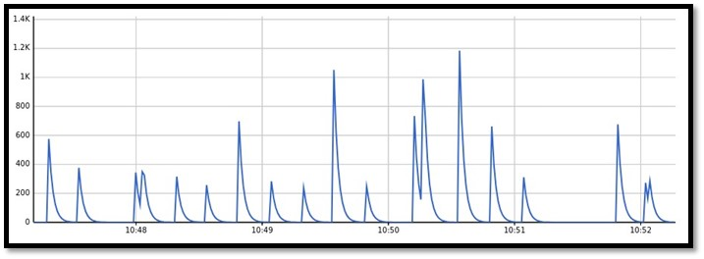
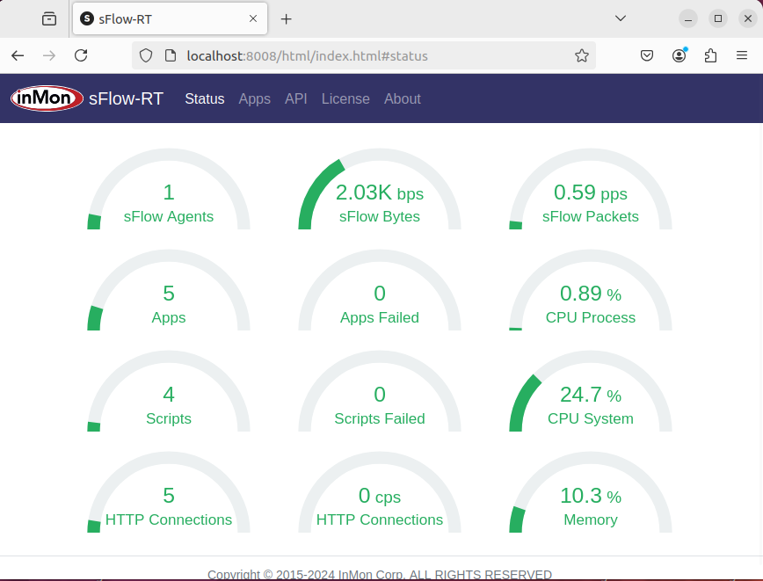
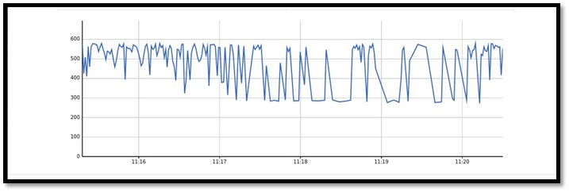
SDN – Distributed Denial-of-Service – Use-Case – Mininet Flow

Slide 35
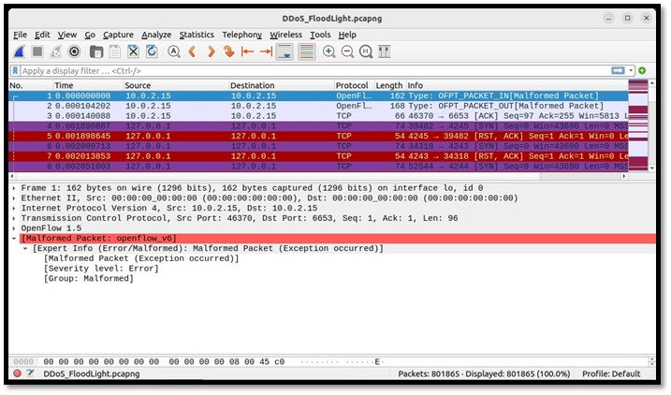
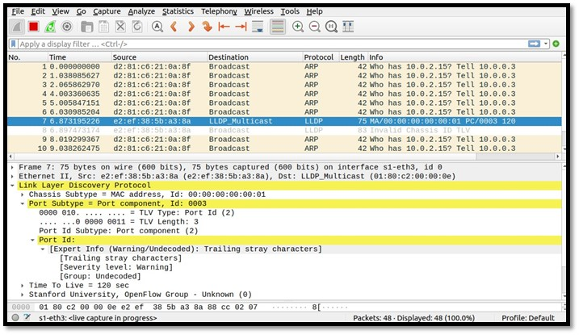
SDN – Distributed Denial-of-Service – Use-Case – Wireshark
From the aforementioned illustrations, it seems that Wireshark has detected the flood DDoS attack with the OpenFlow protocol version 1.5 with security errors as malformed. The destination port is 6653 is used due to the fact that it is the default service port for the FloodLight SDN Controller. On the first illustration we can see the malformed packets sent towards the controller and on the other figure, there are traces of DDoS attack towards a hosting device in Mininet.

Slide 36
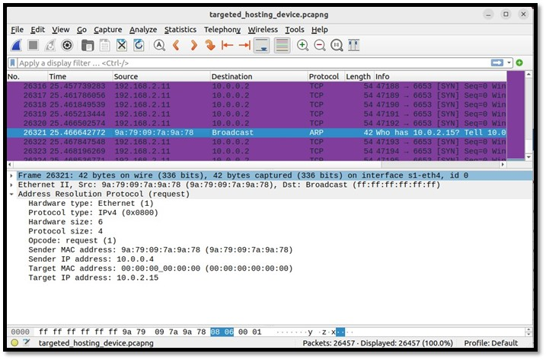
SDN – Distributed Denial-of-Service – Use-Case – Wireshark
Wireshark detected the spoofed packets and displayed the message "acknowledgement number field is nonzero while the ACK flag is not set" ➔ Indication of a potential attack on a transmission protocol level.
Due to the fact that the acknowledgement number is utilized in order to ensure whether the receival of the data was completed successfully or not, through the indication of the following sequence number.
The attacker could have intentionally set the number to a non-zero and not set a flag ➔ Intrusion detection and prevention systems might not have filters for logical correlation amidst the acknowledgment flag and the acknowledgement number ➔ rendering them vulnerable to malicious data packets that could bypass the security as malformed and ignore them ➔ The malicious actor will have successfully evaded the packet filtering.

Slide 37
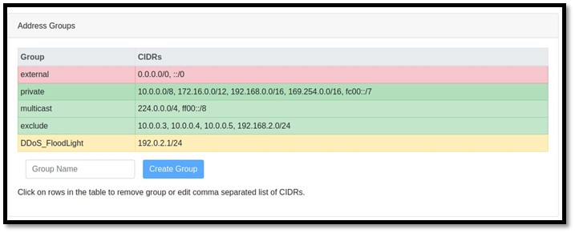
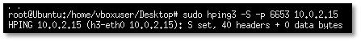
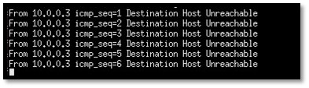
SDN – Distributed Denial-of-Service – Use-Case – Sflow-RT

Slide 38


Thanks! Do you have any questions?
Email: kon.karachalis@aueb.gr
Phone Number: (+30) 6947546603
Alignment: Athens University of Economics & Business
Discord: Kkostakis#2249
LinkedIn: www.linkedin.com/in/konstantinos-karahalis-650964203
Acknowledgements: First and foremost, this is due to the unwavering support of my professor George Xylomenos and as well as the extended insight provided by my friends and colleagues.
Bibliography - References: Regarding the resources that were utilized for the completion of the thesis, they are included in the following link: https://drive.google.com/file/d/1T1y_zUmsILkzZGWI4z9XyScqgYXnvyGN/view?usp=sharing

